Slide 1
Financial Data Analytics Report
By: Moses Oketch
Date: 5th October, 2025

Slide 2
1. Business Understanding
1.1: Project Objective
The primary goal of this project is to analyze financial data in order to provide insights and recommendations for improving the organization's budget performance and identifying tangible cost-saving opportunities. This will be achieved by specifically tracking revenue, expenses, and profit across different product categories and geographical regions.
1.2: Key Business Questions
Which Product categories and regions generate the highest and lowest profits?
What are the monthly sales trend?
Which product/region combinations should be prioritized for increased investment and sales efforts?
Where are the largest sources of expenses, and which regions/products offer the best opportunities for cost-saving?
What data-driven recommendations can be made to inform future budgeting decisions?

Slide 3
Data Understanding
This dataset was obtained from Microsoft Financial Sample Workbook. It contains sales transactional data for different products by country and segments. It has 697 rows and 16 columns.

Slide 4
Data Analysis
Key Findings:

Slide 5
Profit by Product
Products Paseo, Montana and Carretera made profits while products Vello, VTT and Amarrila realized losses.

Slide 6
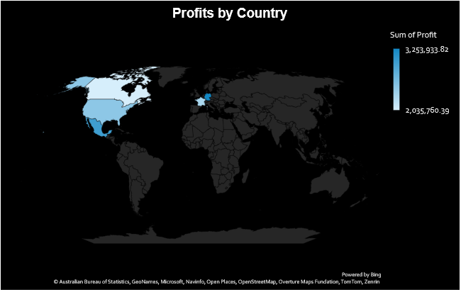
Profits by Region
Germany had the highest profit followed by Mexico, United States, France and Canada.

Slide 7
CoGs by Product and Country
Products VTT, Amarilla and Vello had higher CoGs as compared to others.
Canada France, and USA had higher CoGs

Slide 8
CoGs vs Sales vs Profit per Segment
Government and small business had higher CoGs and also higher sales and profits while Midmarket and Channel Partners had relatively lower CoGs and sales leading to negative profits.

Slide 9
Discount vs Profit by Product
All products had discounts, even though some still made huge losses.

Slide 10
Sales Trend and Profit Margin
Sales were lower at the beginning of the year with highest sales being realized in the month of October.
Paseo with 30% of units sold, Montana and Carretera with 13% of units sold realized profits while VTT and Velo with 15% and Amarilla with 14% units sold made losses. In overall, there was a low profit margin of 11%.

Slide 11
Conclusion
Products such as Paseo, Montana and Carretera made significant profits. This was attributed to lower expenses and higher sales. Products such as Velo, VTT and Amarilla had higher cost of goods thus leading to losses.
Countries such as Germany and Mexico had lower COGs that led to significant profits. Also, Government and Small business segments had higher COGs even though they still made profit.
Monthly sales analysis showed there was noticeable seasonality, with peak sales around October.
Units sold per product does not necessarily translate to higher profits as some products such as VTT had a lot of units sold(15%) but still made losses.
Key factor that generally affects profit by products is the cost of goods sold that varies across different regions and segments. With a profit margin of 11%, this suggest that a significant portion of sales is consumed by expenses. There is also no significant relationship between discount offered and profit realized.

Slide 12
Recommendation
Revenue Growth: Concentrate investment on higher margin products by increasing marketing and sales resource allocations. These products(Paseo, Montana and Carretera) have higher profit margins and sales indicating efficiency and strong market demands.
Optimize efficiency in low margin products: Review production, logistics and distribution costs for products such as VTT, Amarilla and Velo.
Leverage Data-Driven Forecasting and Planning: Use historical monthly trends to create predictive sales models that anticipate seasonal peaks. Align procurement, staffing, and production schedules with these demand cycles to minimize overstocking or shortages.
Reassess Pricing and Discount Strategies: Conduct a detailed discount-effectiveness analysis to ensure that promotional discounts directly translate to higher sales rather than margin erosion. Adopt value-based pricing for high-demand, high-margin products to maximize revenue.
Invest in Continuous Process Improvement: Introduce expense tracking systems to improve decision making speed.
Strengthen higher performing regions: Expand distribution networks and marketing across Regions such as Germany and Mexico.
Segment-Level Strategy: Focus on more sales to Government and small business that already have higher margins.

Slide 13
Thank You.

